Slide 1
Capstone Project
Vijetha Supermarket Pvt. Ltd
Ananya Mantravadi
21f1001142

Slide 2

Business in brief:
Vijetha Supermarkets Pvt ltd is 22 years old company with 70+ outlets in and around Hyderabad & the State of AP. They deal in FMCG, staples, fruits and vegetables and lifestyle products.
One of the pioneer retail companies, now among the biggest Food & Grocery retailers in Hyderabad & the State of AP
Branch/Outlet Location: My Home Vihanga, Gachibowli, Hyderabad - 500032 (Gated Community)
Website - http://vijetha.in
Notes:
So, starting off, here is a small introduction to the business. Vijetha supermarkets is a 22 years old retail company. They deal with FMCG, staples, fruits and vegetables, and lifestyle products. They have more than 70 outlets in Hyderabad and Andhra Pradesh.
It was among the first retail companies and now one of the biggest Food & Grocery retailers.
The outlet from where I have collected is located at My Home Vihanga, Gachibowli in Hyderabad.
And here is the website of the company.

Slide 3
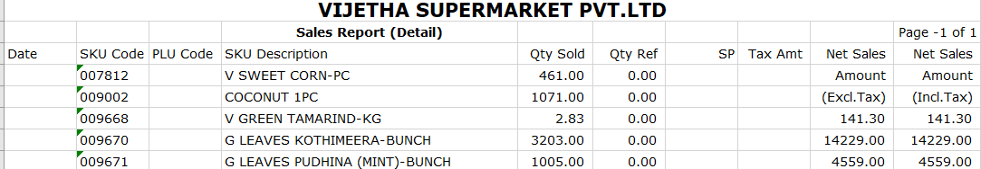
Data Collection
Visited Vijetha Supermarket outlet in my residence, a gated community.
Negotiated with Branch Manager
Agreed to share a subset of their data of vegetables category
Data shared in aggregated manner - monthly summary from January to June 2021 in .xls format
Sample of the Dataset:
Notes:
Initially I planned to collect data from few sweet shops near my house. I even asked my friends who knew businesses - but they all eventually couldn’t disclose their data due to because most of them did not collect data consistently or had maintained records. Others denied due to their confidentiality reasons. I was finally able to obtain data after negotiating with the branch manager at Vijetha Supermarket. This is the supermarket inside my place of residence which is a gated community. So, the branch manager said they can’t share their whole data, but can share a subset of their data like in the category of vegetables. I requested for data over 6 months, and he manually extracted it for each month from their database in their retail management software. The data for each month was aggregated - so I had one data point for each month. He shared 6 excel sheets with me in this way. So I had data from January to June 2021. I added a screenshot of a sample of a sheet from one month. There were columns of SKU Code, SKU description, quantity sold, tax amount, net sales excluding and including tax. Since tax is not applicable on vegetables the last two columns had the same value.

Slide 4
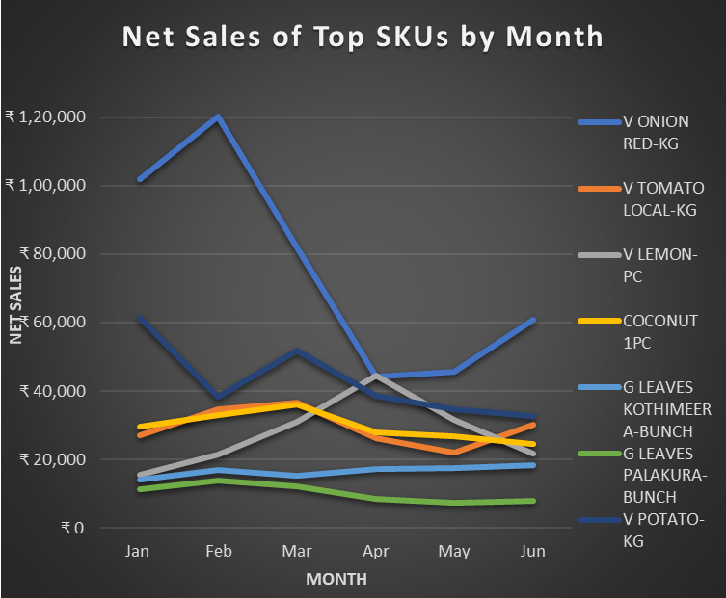
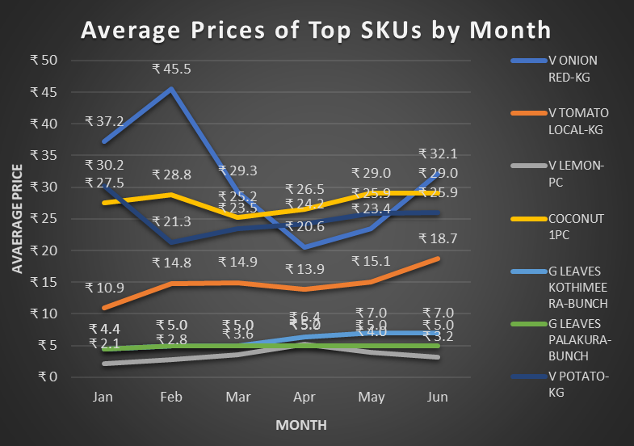
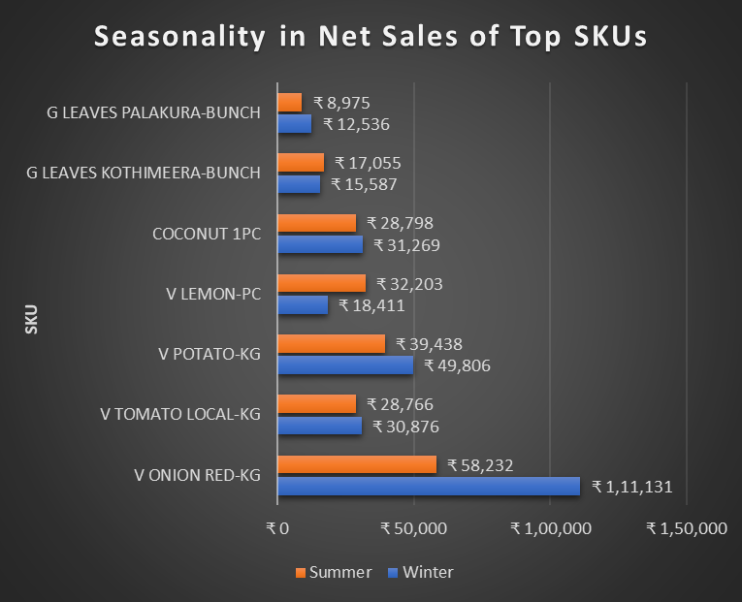
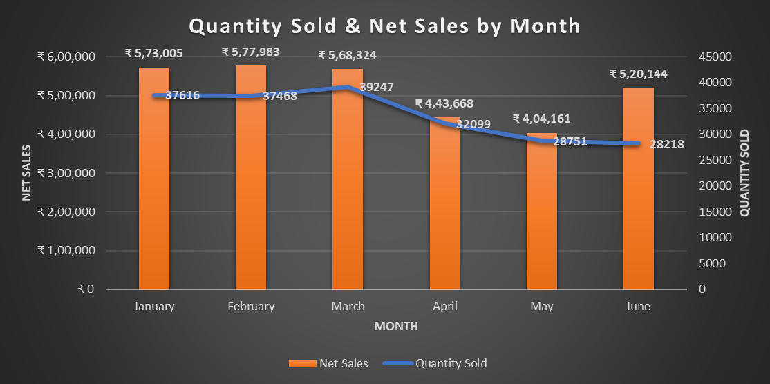
Analysis & Interpretation:
Raw data clubbed SKUs measured in KG, PC and Bunch
Different set of vegetables every month
Drop in April & May: Residents leaving to native places during the peak of second wave of Covid-19 / online purchases
Major Contributors by sales: Onions (~15%), Potatoes (8%), Coconuts (6%)
Avg. Net Sales: ₹ 5,14,548
Avg. Qty Sold: 33900
Overall
Top SKUs by Net Sales |  | Top SKUs in Qty KG |  | Top SKUs in Qty PC |  | Top SKUs in Qty Bunch
V ONION RED-KG | ₹ 75,865 | V ONION RED-KG | 2363.8 | V LEMON-PC | 5216.7 | G LEAVES KOTHIMEERA-BUNCH | 2910.1
V POTATO-KG | ₹ 42,894 | V TOMATO LOCAL-KG | 2039.9 | COCONUT 1PC | 1078 | G LEAVES PALAKURA-BUNCH | 2079.6
COCONUT 1PC | ₹ 29,622 | V POTATO-KG | 1704.2 | V DRUMSTICK-PC | 862.6 | G LEAVES MENTHI-BUNCH | 1626
V TOMATO LOCAL-KG | ₹ 29,469 | V CARROT-KG | 535.9 | V MULLANGI (RADISH)-PC | 850 | G LEAVES CURRY LEAVES-BUNCH | 1021.3
Notes:
Once i had all the 6 months’ sheets, I first tried to combine it all in a single sheet to perform easier analysis. It was then that I realised that there were different set of vegetables every month. I then added all the rows from all sheets using vlookup and sorted them to keep only the distinct SKUs. This resulted in NA values for vegetables which weren’t available for that month. There were few missing values due to the initial formatting of the sheet, and I used simple linear regression to get a possible value to be imputed. This brought down the total sales difference from given net sales and my calculated net sales down from 35,000 to about 3,000.
( I discarded some values which had sales and quantity sold of less than one rupee.)
After looking at the data for each month, another observation I made was that different categories of vegetables were all clubbed together. Vegetables which were measured in KG, by pieces and by bunches, they were all put together. To make it a meaningful comparison, I segregated these categories for each month. For each month, I identified top SKUs with respect to their average price, net sales and quantity sold. Then using this I tabulated overall top SKUs over the 6 months. These were top SKUs by Net Sales, by Quantity sold in kg, pieces, bunches and average prices. This table i added on the slide here contains these values.
Then I tried to look at the monthly trends. These plot shows net sales of Top SKUs by month…. We can immediately see that there was a drop in the months of April and May sales by more than one lakh rupees. This was during the peak of the second wave of covid 19 pandemic.
The possible explanations for this are that many families moved out to their native places, or were hesitant to purchase from the store physically and instead made online purchases during the peak of the second wave of the pandemic - resulting in lower sales. Among the top SKUs, only onions had fluctuating price and sales as compared to the others.
Another plot shows the seasonality trend for the top SKUs in winter and summer. I considered the months Jan & Feb as winter and the rest of the four months as summer. The net sales are the average of these months. Most of the SKUs don’t show much of a seasonal effect apart from onions and lemons. Onions had about 50,000 rupees of more sales in winter compared to summer, while lemons had 14,000 rupees of more sales in summer compared to winter.
Comparing the contributions we can see that the top major contributors to net sales are onions (15%), potatoes (8%) and coconuts (6%) on average over the six months. The average net sales is ~₹ 5,14,548 and average quantity sold is ~33900 from January through June.

Slide 5
Recommendations
Net sales of onions being highest and its prices fluctuating most often, buying more stock when prices are lower and maintaining its quality/shelf life for a longer time will help increase profitability.
Adequate stock for the top selling SKUs must be maintained as demand for them is constantly high.
Notes:
Based on the analysis and interpretation I came up with the following recommendations.
Net sales of onions being highest and its prices fluctuating most often, buying more stock when prices are lower and maintaining its quality/shelf life for a longer time will help increase profitability. As we noticed that onions net sales and quantity sold is consistently high, buying more stock at lower prices can be quite beneficial
Adequate stock for the top selling SKUs must be maintained as demand for them is constantly high. In this way we can ensure good amount of sales.

